Slide 1
CM1605 Web Technology
Introduction to Web Technologies & HTML I
Week 1| Janani Harischandra

Slide 2
Learning Outcomes
Covers LO1 and LO2 for Module
On completion of this lecture, students are expected to be able to:
Define a computer network, internet, internet protocols, internet addressing, domain name servers, URL and URI,
Describe different web application architectures, web servers, web browsers and web search engines and give real world examples of them.
Define and understand SGML, XML, HTML terminologies.
Understand and describe HTML page structures.
Apply hypertext concepts in making hypertext documents using the current HTML standard with different Text formatting tags, Logical tags, Links, Lists.

Slide 3
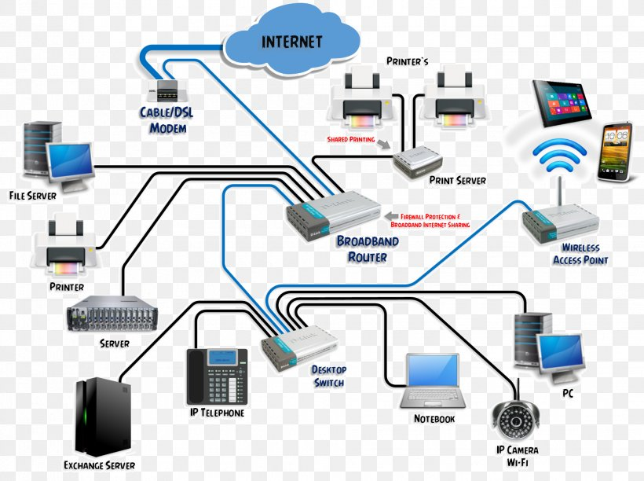
Computer Networks
A computer network can be defined as a set of computers (nodes) and different other computing hardware devices connected through communication channels (cabling/wireless) to facilitate communication and resource sharing among a wide range of users.

Slide 4
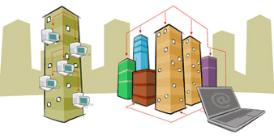
Computer Network Types
LAN (Local Area Network)
Is a group of computers connected to each other in a small area such as building, office which connects two or more personal computers through a communication medium such as twisted pair, coaxial cable, etc.
It is less costly as it is built with inexpensive hardware such as hubs, network adapters, and Ethernet cables.
WAN (Wide Area Network)
is a network that extends over a large geographical area such as states or countries connected through a telephone line, fibre optic cable or satellite links.
The internet is one of the biggest WAN in the world.
LAN
WAN

Slide 5
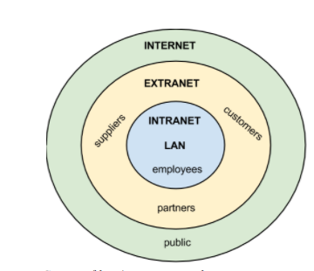
Scope of business networks

Slide 6
History of Internet
In late 1960’s ARPANET was invented by a group of MIT graduate students which later evolved in to Internet today.
ARPANET primary goals was to allow multiple users to send and receive information simultaneously over the communication paths(eg: phone lines).
History - https://www.computerhistory.org/internethistory/

Slide 7

Internet
The Internet is a global wide area network that connects computer systems across the world which exchange data cooperating with each other.
Read More About
Internet - https://www.youtube.com/watch?v=7_LPdttKXPc
https://www.youtube.com/watch?v=x3c1ih2NJEg

Slide 8
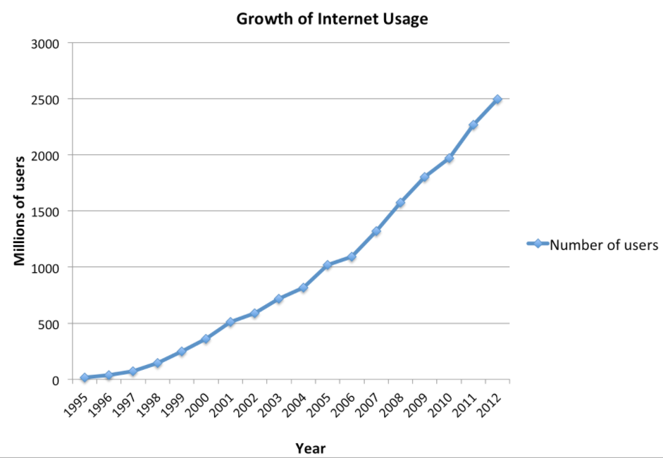
Growth of Internet
Growth of internet usage, 1995–2012 .Data taken from InternetWorldStats.com.

Slide 9
World Wide Web Consortium (W3C)
In 1994, World Wide Web Consortium (W3C) was founded to develop non proprietary technologies for the web.
Primary to goal is to W3C’s to make the web universally accessible – regardless of ability , language or culture.
Web technologies standardized by the W3C are called Recommendations.

Slide 10
Internet Communication
Protocols
Addressing
IP Address
Domain Name
URL

Slide 11
Protocols
Protocols are set of rules for routing and addressing packets of data so that they can travel across networks and arrive at the correct destination.
Examples :
HTTP - Hypertext Transfer Protocol
HTTPS - Secure Hypertext Transfer Protocol
TCP/IP – Transmission Control Protocol / Internet Protocol
FTP – File Transfer Protocol

Slide 12
Internet Addressing
Every computer / device connected to the Internet has a unique identity.
The main objective of internet addressing is to locate each device/host/computer by a unique address.
There are different types of addressing introduced in order to achieve the above purpose.
Types of internet addressing
Internet Protocol address (IP)
Domain Name Server address (DNS)

Slide 13
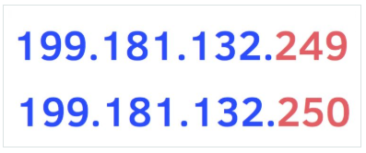
Internet Protocol Address (IP)
Every machine/device on network has a unique identifying number, called an IP Address.
(router,smartphone,etc)
A typical IP address looks like this(ipv4):
The format of an IP address is a 32-bit numeric address with 12 digits written as four numbers separated by periods/full stops where each num­ber can be a num­ber between zero and 255.
When con­struct­ing a net­work, IP addresses can be assigned ran­domly pro­vided that each IP address is a unique address, this unique­ness is essen­tial to avoid send­ing data to mul­ti­ple des­ti­na­tions or to the wrong destination.

Slide 14
Brainstorm
What is Ipv6? And Why?

Slide 15
Domain Name Server (DNS)
Friendly addressing (DNS), introduced to help users remembering (or even guessing) the name of a host.
Advantage:
Numeric addresses are difficult to work with
Extremely difficult to remember as humans
Eg:
http://10.0.7.200:8080 Vs. http://moodle.sliit.lk
Disadvantage:
Unable to generate meaningful and unique names for all devices in the Internet

Slide 16
Domain Levels
Domain names are organized in a hierarchical manner.
Top Level Domain (TLD) : Last part of the Domain name
e.g. : org is TLD of www.wikipedia.org
Second Level Domain: Name directly to the left of TLD
e.g. : wikipedia is SLD of www.wikipedia.org
Third Level Domain: Name directly to the left of second level Domain
e.g. : mail is SLD of mail.google.com
Notes:
departments of a company. In larger organizations each division or department might have its own third level domain, which can The third-level domain name is used to refer to different servers within different serve as an effective means for identifying it. www is the default third-level domain name and the most commonly used. The third level domains are not mandatory unless the user has a specific requirement.
For example: www.furniture.net is a third-level domain. .net is a top-level domain and furniture is the domain name. The www is third-level domain.

Slide 17
Top Level Domain Types
Commercial Organizations com
Educational Institute edu
Government Institute gov
Military Groups mil
Major network support centers net
Non profit Organizations org
International Organizations int

Slide 18
Domain Name System(DNS)
The Domain Name System (DNS) works as the phonebook of the Internet.
DNS servers eliminate the need for humans to memorize IP addresses such as 192.168.1.1 (in IPv4) and IPv6.
DNS is a database system that translates a computer's fully qualified domain name into an IP address.
The DNS functions by converting the domain name into an IP address character set, via a Domain Name System server.

Slide 19
Domain Name Resolution
When you type web address in your browser eg: google.com, bbc.co.uk, ebay.com.
Your computer contacts DNS servers which returns the IP address associated with the requested domain name.
The unique number that the DNS server returns to your computer allows your browser to contact the web server that hosts the website requested.
Translating the name into the IP address is called “resolving the domain name” or “DNS resolution”.
If a name server in the local domain cannot resolve a client's request, it queries other servers to locate a server that can.

Slide 20

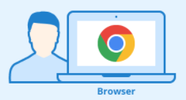


Domain Name Resolution
DNS Resolution
www.ebay.com
12.34.56.78
12.34.56.78

Slide 21
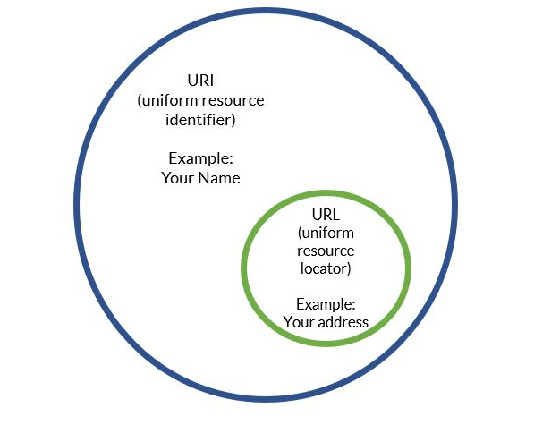
Uniform Resource Identifier (URI)
URI can be a name, locator, or both for resource in the web where a URL is just the locator.
URLs are a subset of URIs.
All URLs are URIs. It doesn't work the opposite way though.

Slide 22

Web Page Addresses (URLS)
Every web page and resource on the web has its own special address called a URL.
URL stands for Uniform Resource Locator.
This is the web address that you would type into a browser if you wanted to visit that specific page.

Slide 23
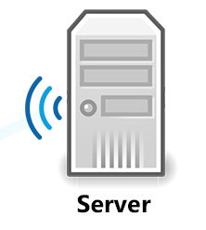

Client Sever Architecture
Request
Response
Client/server describes the relationship between two computer programs in which one program, the client, makes a service request from another program, the server, which fulfils the request
Server
Computer program or machine that provide services to (Web Services or FTP services) to other programs or users(machines).
Client
Computer program or machine that request the services from servers.

Slide 24
Types of Client Server Architecture
1-Tier Architecture
2-Tier Architecture
3-Tier Architecture
N-Tier Architecture

Slide 25
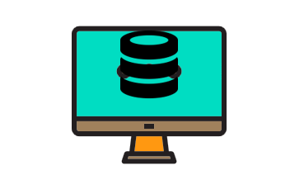
1- Tier Architecture
It is the simplest one as it is equivalent to running the application on the personal computer. All of the required components for an application to run are on a single application or server including Client, Server, Database.

Slide 26
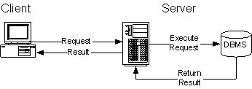
2-Tier Architecture
A two-way interaction in a client/server environment, in which the user interface is stored in the client and the data are stored in the server.
The application logic can be in either the client or the server.

Slide 27
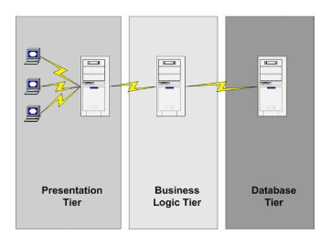
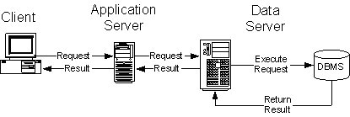
3-Tier Architecture
A three-way interaction in a client/server environment, in which the user interface is stored in the client, the bulk of the business application logic is stored in one or more servers, and the data are stored in database server.
The 3-tier architecture is split into 3 parts, namely, The presentation layer (Client Tier), Application layer (Business Tier) and Database layer (Data Tier).
The Client system manages Presentation layer; the Application server takes care of the Application layer, and the Server system supervises Database layer.

Slide 28
N-Tier Architecture
The N-tier (multi-tier) architecture is an industry-proven software architecture model.
There are different types of N-Tier Architectures such as 3-tier Architecture, 2-Tier Architecture and 1- Tier Architecture.
It is suitable to support enterprise level client-server applications by providing solutions to scalability, security, fault tolerance, reusability, and maintainability.
Read More : https://www.guru99.com/n-tier-architecture-system-concepts-tips.html

Slide 29
Web Browsers
Web browsers are software programs that allow users to access the web’s rich content.
Information Resources : Images, videos, and other piece of content. Hyperlinks present in resources enable users to easily navigate their browsers to related resources.
People use web browsers for different purposes such business, personal to access tremendous amounts of information available on the web.
The popular browsers today are Google Chrome, Firefox, Safari, Edge

Slide 30
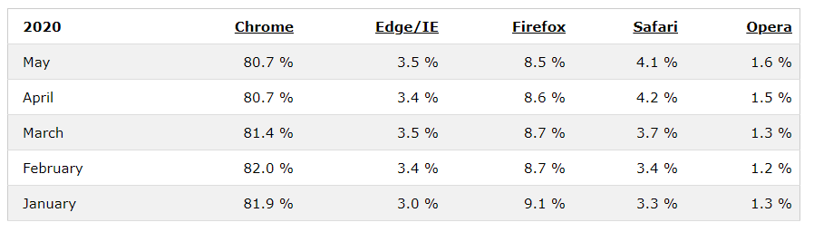
Web Browser Usages
Read More : https://www.w3schools.com/browsers/default.asp

Slide 31
Web Servers
A web server: computers on the Internet that host websites, serving pages to viewers upon request.
Each web server has a unique address (IP address) and domain name and Provide services such as Web hosting.
Any computer can be turned into a Web server by installing server software and connecting the machine to the Internet.
Read more: https://w3techs.com/technologies/overview/web_server

Slide 32
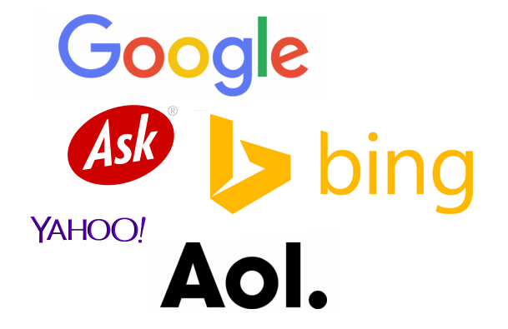
Web Search Engines
A web search engines can be named as a specialized tool which enables users to locate/explore information on WWW in a systematic way.
The search results of a user query are often returned as a list.
The list may consist of web pages, images, and other types of files.
Some popular web search engines – Google, Yahoo, bling, msn, Ask.

Slide 33
Further Reading
Deitel, P.J., and Deitel, H.M. (2005), Internet and World Wide Web How to program, Pearson.
Duckett, J. (2011), HTML & CSS, Design and Build Websites, Wiley.
Robbinson, J . (2018), Learning Web Design, A Beginner’s Guide to HTML,CSS, JavaScript, And Web Graphics, O’Reilly.

Slide 34
Content
Client and Server Side Technologies
Markup Language
HTML and XML
HTML 5
HTML Terminologies
Basic HTML page structure
Basic HTML tags
Text formatting tags
Logical tags
List tags
HTML Links

Slide 35
Client Side Techniques for Web Development
HTML
Hyper Text Markup Language used to create static web pages.
CSS
Cascade Style Sheets used to define styles for HTML pages.
XML
Extensible Markup Language used to store and transport data.
Java Scripts
A scripting language that enables creating dynamically updating content, control multimedia, animate images.

Slide 36
Server Side Techniques for Web Development
PHP
Personal Home Page is used to create dynamic and interactive web pages.
JSP
Java Server Pages is a Java standard technology used to create dynamic data driven web pages.
ASP.Net
A new framework for creating web applications.
Python
Python offers man frameworks web application development

Slide 37
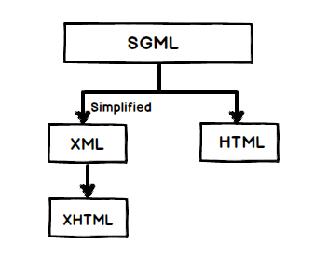
Markup Language (SGML)
SGML stands for Standard Generalized Markup Language.
It is a standard for how to specify a document markup language or tag set.
SGML is based on the idea that documents have structural and other semantic elements.
Developed and standardized by the International Organization for Standards (ISO) in 1986.

Slide 38
HTML
HTML (Hyper Text Markup Language) is the standard markup language for Web pages.
It is the standard markup language for creating Web pages.
HTML elements tell the browser how to display the content.
HTML web pages are text documents.
HTML uses tags (characters that sit inside angled brackets) to give the information they surround special meaning.
Tags are often referred to as elements.

Slide 39
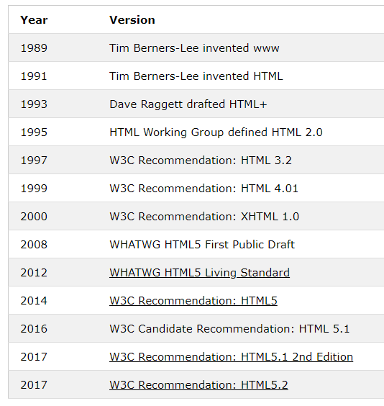
HTML History

Slide 40

HTML 5
HTML5 is the newest version of HTML.
It incorporates all features from earlier versions of HTML, including the stricter XHTML.
Read more on HTML 5
https://html.spec.whatwg.org/#is-this-html5?
https://www.w3.org/TR/2008/WD-html5-20080122/

Slide 41
Why HTML 5?
It promotes cross platforms.
Improves semantic definitions.
Consistency across of multiple browsers.
A better user experience with a wider range of design and presentation tools across media types.
Reduce the need for external plugins and scripts to show website content.
Handle web documents errors in a better and more consistent fashion.

Slide 42
XML
XML is a software- and hardware-independent tool for storing and transporting data.
XML has following features
XML stands for Extensible Markup Language
XML is a markup language much like HTML
XML was designed to store and transport data
XML was designed to be self-descriptive
XML is a W3C Recommendation

Slide 43
Difference (HTML & XML)
XML and HTML were designed with different goals:
XML was designed to carry data - with focus on what data is
HTML was designed to display data - with focus on how data looks
XML tags are not predefined like HTML tags are

Slide 44
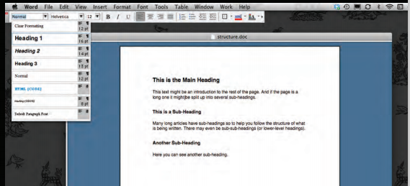
Structuring Word Documents
The use of headings and subheadings in any document often reflects a hierarchy of information.
Eg: document might start with a large heading, followed by an introduction or the most important information.
This might be expanded upon under subheadings lower down on the page.
In the browser window you can see a web page that features exactly the same content as the Word document.

Slide 45

Understanding the Document Structures
What do you see in a newspaper? Stories
Each Story has
Headline
Sub Headings
Paragraphs
Images
Quotes
The structure is very similar when a news story is viewed online (although it may also feature audio or video)
Notes:
We come across all kinds of documents every day of our lives. Newspapers, insurance forms, shop catalogues... the list goes on.
Think about the stories you read in a newspaper: for each story, there will be a headline, some text, and possibly some images. If the article is a long piece, there may be subheadings that split the story into separate sections or quotes from those involved. Structure helps readers understand the stories in the newspaper.
The structure is very similar when a news story is viewed online (although it may also feature audio or video). This is illustrated on the right with a copy of a newspaper alongside the corresponding article on its website. Now think about a very different type of document — an insurance form. Insurance forms often have headings for different sections, and each section contains a list of questions with areas for you to fill in details or checkboxes to tick. Again, the structure is very similar online

Slide 46
HTML Terminology
HTML elements
Made up of characters that live inside angled brackets. Eg:<head>
Elements are usually made up of two tags: an opening tag and a closing tag. Eg:<head> </head>
Each HTML element tells the browser something about the information that sits between its opening and closing tags.

Slide 47
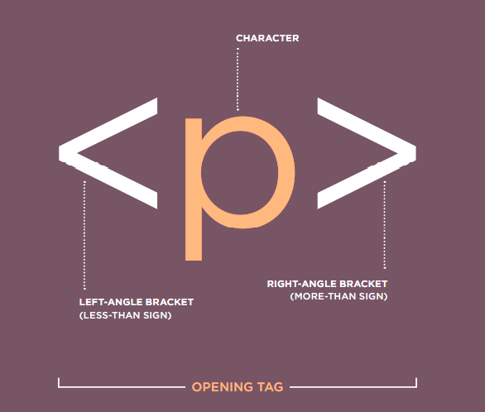
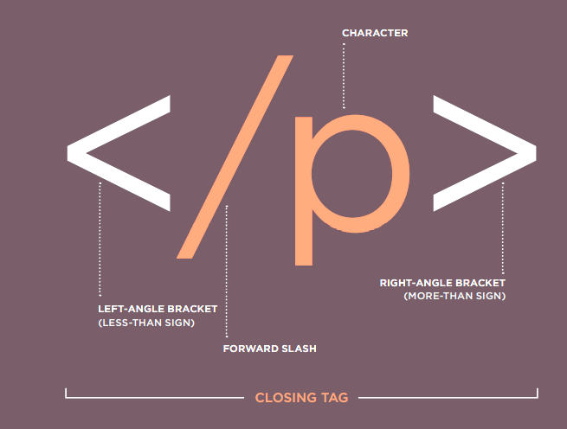
HTML Terminology

Slide 48
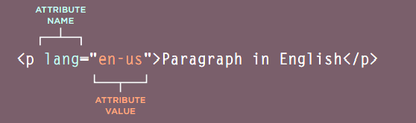
HTML Terminology
Attributes
Attributes provide additional information about the contents of an element.
They appear on the opening tag of the element and are made up of two parts: a name and a value, separated by an equals sign.
The attribute name indicates what kind of extra information you are supplying about the element's content. It should be written in lowercase.
The value is the information or setting for the attribute. It should be placed in double quotes.

Slide 49
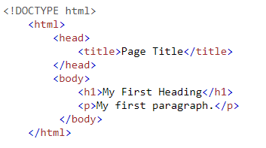
HTML Basic Page Structure

Slide 50
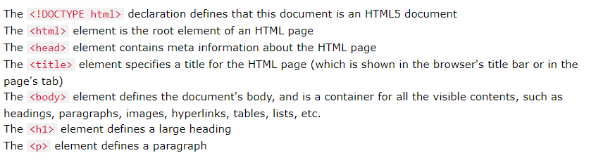
HTML Basic Page Structure

Slide 51
HTML Page
HTML Markup | Formatted Text
<!DOCTYPE html> <html> <head> <title>Page Title</title> </head> <body> <h1>My First Heading</h1> <p>My first paragraph.</p> </body> </html> | My First Heading My first paragraph.

Slide 52
HTML Meta data
Metadata is data (information) about data.
<meta> tags always go inside the <head> element, and are typically used to specify character set, page description, keywords, author of the document, and viewport settings.
Metadata will not be displayed on the page, but is machine parsable.
Metadata is used by browsers (how to display content or reload page), search engines (keywords), and other web services.
Eg:
Define keywords : <meta name="keywords" content="HTML, CSS, JavaScript">
Define a description : <meta name="description" content="Free Web tutorials for HTML and CSS">
Define the author: <meta name="author" content="John Doe">
Refresh document every 30 seconds: <meta http-equiv="refresh" content="30">

Slide 53

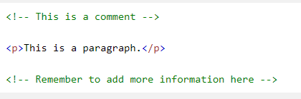
HTML Comments
HTML comments are not displayed in the browser, but they can help document your HTML source code.
Comments are great for debugging HTML.
Comments can be added to HTML source code by using the following syntax:

Slide 54
HTML Headings
HTML has six "levels" of headings: <h1>……..<h6>
<h1> is used for main headings <h2> is used for subheadings.
Browsers display the contents of headings at different sizes.
HTML Markup | Formatted Text
<!DOCTYPE html> <html> <body> <h1>Heading 1</h1> <h2>Heading 2</h2> <h3>Heading 3</h3> <h4>Heading 4</h4> <h5>Heading 5</h5> <h6>Heading 6</h6> </body> </html> | Heading 1 Heading 2 Heading 3 Heading 4 Heading 5 Heading 6

Slide 55
HTML Text Formatting Tags
<b> - Bold text
<strong> - Important text
<i> - Italic text
<em> - Emphasized text
<mark> - Marked text
<small> - Smaller text
<del> - Deleted text
<ins> - Inserted text
<sub> - Subscript text
<sup> - Superscript text
<p> - Paragraph

Slide 56
HTML Semantic Tags
There are some text elements that are not intended to affect the structure of your web pages, but they do add extra information to the pages.
<em>text</em>
<strong>text</strong>
<var>name</var>
<dfn>a definition</dfn>
<cite>a citation.</cite>
<address>Janani.h@iit.ac.lk</address>
<code> Represents computer code </code>
<blockquote>text</blockquote>
<abbr>IIT</abbr>

Slide 57
Other Useful HTML tags
Rulers
<hr>
Paragraphs & Line Breaks
<p>This is a parahraph</p>
<br> Line Breaks

Slide 58
HTML List Tags
HTML provides us with three different types:
Ordered lists are lists where each item in the list is numbered.
Eg: The list might be a set of steps for a recipe that must be performed in order, or a legal contract where each point needs to be identified by a section number.
Unordered lists are lists that begin with a bullet point (rather than characters that indicate order).
Definition lists are made up of a set of terms along with the definitions for each of those terms.

Slide 59
Ordered Lists
HTML Markup | Formatted Text
<!DOCTYPE html> <html> <body> <h2>An ordered HTML list</h2> <ol> <li>Coffee</li> <li>Tea</li> <li>Milk</li> </ol> </body> </html> | An ordered HTML list Coffee Tea Milk

Slide 60
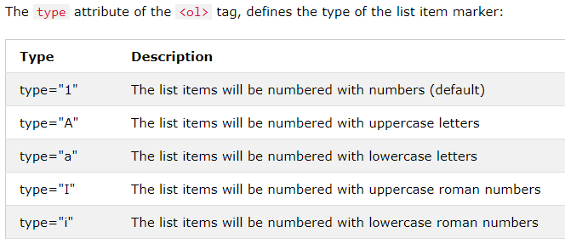
Ordered HTML List - The Type Attribute

Slide 61
Unordered Lists
HTML Markup | Formatted Text
<!DOCTYPE html> <html> <body> <h2>An unordered HTML list</h2> <ul> <li>Coffee</li> <li>Tea</li> <li>Milk</li> </ul> </body> </html> | An unordered HTML list Coffee Tea Milk

Slide 62
Definition Lists
HTML Markup | Formatted Text
<!DOCTYPE html> <html> <body> <h2>A Description List</h2> <dl> <dt>Coffee</dt> <dd>- black hot drink</dd> <dt>Milk</dt> <dd>- white cold drink</dd> </dl> </body> </html> | A Description List Coffee - black hot drink Milk - white cold drink

Slide 63
Links
Links are the defining feature of the web because they allow you to move from one web page to another.
You will commonly come across the following types of links:
Links from one website to another
Links from one page to another on the same website
Links from one part of a web page to another part of the same page
Links that open in a new browser window
Links that start up your email program and address a new email to someone

Slide 64
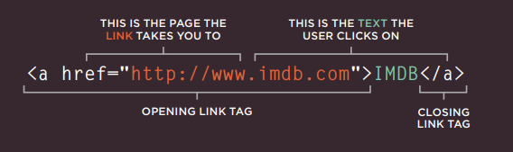
HTML Links
Links are created using the <a> element. Users can click on anything between the opening tag <a> and the closing </a> tag.
You specify which page you want to link to using the href attribute.

Slide 65
HTML Link Types
Absolute links - Takes the user to a specific page on the Web outside of the current website which contains the complete web URL.
E.g: “http://www.iit.ac.lk”
Relative links - Refer to pages on the same website. Do not need to specify the domain name in the URL.
/courses
/graphics/image.png
Internal Links - Accessing to different sections of the same page
In addition, links can be created to download external files or Audio and video files.

Slide 66
HTML Links - The target Attribute
By default, the linked page will be displayed in the current browser window. To change this, you must specify another target for the link.
The target attribute specifies where to open the linked document and will have below values:
_self - Default. Opens the document in the same window/tab as it was clicked
_blank - Opens the document in a new window or tab
_parent - Opens the document in the parent frame
_top - Opens the document in the full body of the window

Slide 67
HTML email Link
Element <a> is used to create a link that starts up the user's email program and addresses an email to a specified email address,
The value of the href attribute starts with mailto: and is followed by the email address you want the email to be sent to.

Slide 68
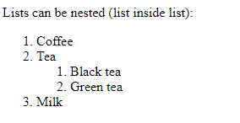
Review Questions
Question 1 - Which HTML tags are introduced with HTML 5?
Question 2 - Which HTML tags are used to create an ordered list?
Question 3 - Write the HTML tags to display the following nested list.

Slide 69
READING
Duckett, J. (2011), HTML & CSS, Design and Build Websites, Wiley.
Castro & Hyslop, B.(2011), HTML5&CSS: Visual QuickStart Guide, Peachpit Press.
Robbinson, J . (2018), Learning Web Design, A Beginner’s Guide to HTML,CSS, JavaScript, And Web Graphics, O’Reilly.
Online :
http://www.w3schools.com/html/
https://www.udemy.com/learn-html5-programming-from-scratch/

